Slide 1


CSA1110 OBJECT ORIENTED ANALYSIS AND DESIGN
UML Modeling for Hospital
Management System
Presented by:
Guided by:
Loshini L (192571015)
Dr. MANIMARAN.A

Slide 2



Introduction
A Hospital Management System (HMS) helps hospitals manage their daily activities.
It stores patient records, doctor schedules, appointments, and billing details .
It reduces paperwork and improves the accuracy of information.
UML diagrams are used to design and understand the system before development.
UML helps developers and stakeholders communicate better and makes the system easier
to maintain and improve.

Slide 3


Problem Identification
Patient records are difficult to manage manually.
Doctor schedules may overlap or cause confusion.
Appointment booking can be slow and unorganized.
Billing errors can occur due to manual calculations.
Lack of a proper system leads to delays and poor hospital management.

Slide 4
Proposed Solution
Develop a Hospital Management System using UML design.
Use a Use Case Diagram to show how users interact with the system.
Use a Class Diagram to organize patients, doctors, appointments, and
billing.
Use a Sequence Diagram to show the step-by-step flow of system
operations.
The system will improve efficiency, reduce errors, and make hospital
management easier.

Slide 5


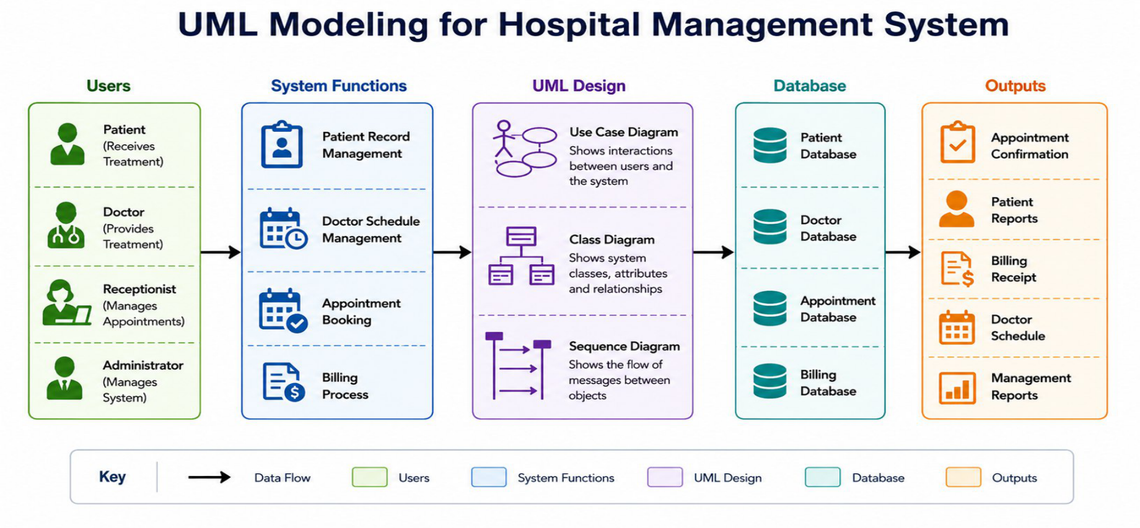
Architecture

Slide 6
Use Case Diagram
Shows the interaction between users and the Hospital
Management System.
Main users are Patient, Doctor, Receptionist, and
Administrator.
Displays functions like patient registration, appointment
booking, billing, and record management.
Helps understand the system requirements clearly.
Makes communication easier between developers and
stakeholders.

Slide 7
Class Diagram
Shows the structure of the Hospital
Management System.
Includes classes like Patient, Doctor,
Appointment, and Billing.
Shows the attributes and functions of each
class.
Displays the relationships between different
classes.
Helps developers design the system in an
organized way.

Slide 8
Sequence Diagram
Shows the step-by-step flow of a process.
Displays how objects communicate with each other.
Explains the order of messages during an operation.
Example: Patient books an appointment → Doctor
confirms → Billing is generated. Helps understand the
system's behavior clearly.

Slide 9
Conclusion
UML diagrams help design the Hospital Management System
in a clear and organized way.
They make it easy to understand the system's structure and
workflow.
UML improves communication between developers, users, and
stakeholders.
The system becomes easier to develop, maintain, and update.
Overall, UML helps create an efficient, reliable, and scalable
Hospital Management System.

Slide 10
THANK YOU

